Slide 1
Team Blue Dots NSWC Port Hueneme Division NSWC Philadelphia Division

Slide 2
How we attacked the problem
Challenge 1
AIS Data
Preprocessing Filter 1 - Find Ships in Close Proximity
Preprocessing Filter 2 & Identifying Potential COLREGS
Visualization
Challenge 2
AIS Data
Modeling Ship Tracks
Visualize Predicted Track

Slide 3
Pre-processing Filter 1 Methodology
Filter out ships that are moored or are tug boats
Analyze one day of data at a time
Create box based on max/min Lat/Lon of data from given day
Loop through sub boxes of 8,000 yards in height/width
Create list of all MMSI ids that went through each sub box
Compare start and end times for each ship combinations
If there is an overlap of time, check distance between them
Compile data of ships that were less than 8,000 yards apart

Slide 4
Accomplishments
Implemented
Loop through data one day at a time
Create larger box from data and loop through smaller sub boxes
Check for ships and create combinations for comparison within each sub box
Compare timespans of ships within each sub box for overlap
Keep track of combinations of ship comparisons to reduce duplicates
Yet to implement
Combine ship information for each interaction and exporting data to CSV

Slide 5
Potential Improvements
Current algorithm only checks one data point per interaction
Ships may not be within 8,000 yards at that point but may end up closer to each other at different data points
Altering size of sub boxes
Larger sub box size may reduce number of sub box loops but could increase number of checks of non-valid ship interactions

Slide 6
Results
AIS 2017 12 Zone11
Day 1
Time to process: 16.3 minutes
Number of interactions detected: 15,296
Day 2
Time to process: 17 minutes
Number of interactions detected: 16,173
Note
Data processing time is low due to not collecting ship information for CSV export

Slide 7
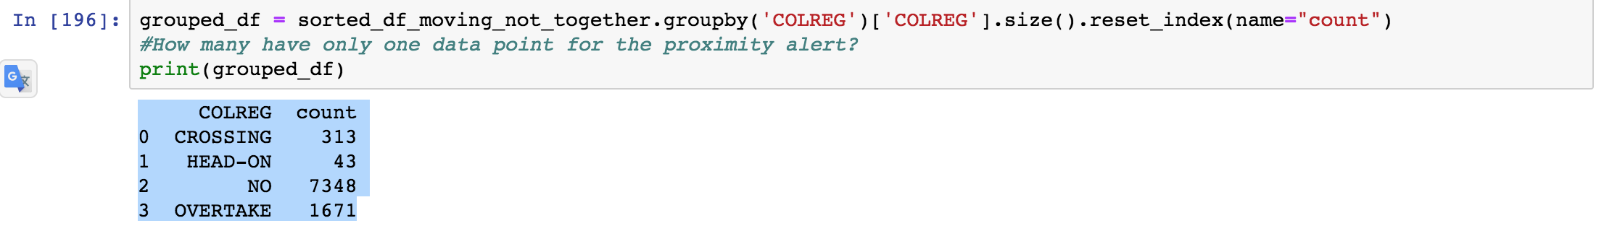
Pre-processing Filter 2 & Categorizing COLREGS
Read in proximity data from first filter
Remove data that represents situations that are definitely not COLREGS
Removed all instances where both ships are stationary
Removed all instances where two ships are going in the same direction at the same speed
Then categorize the remaining data
Overtake
Collision
Head-on

Slide 8
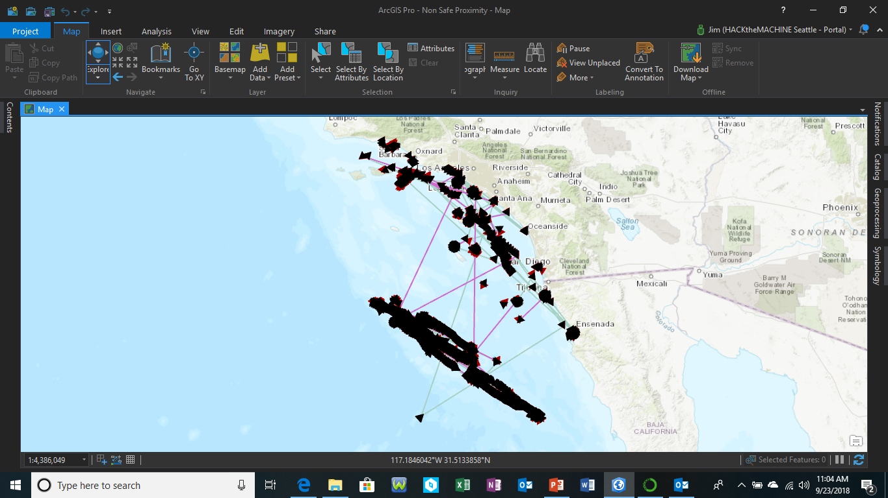

Slide 9
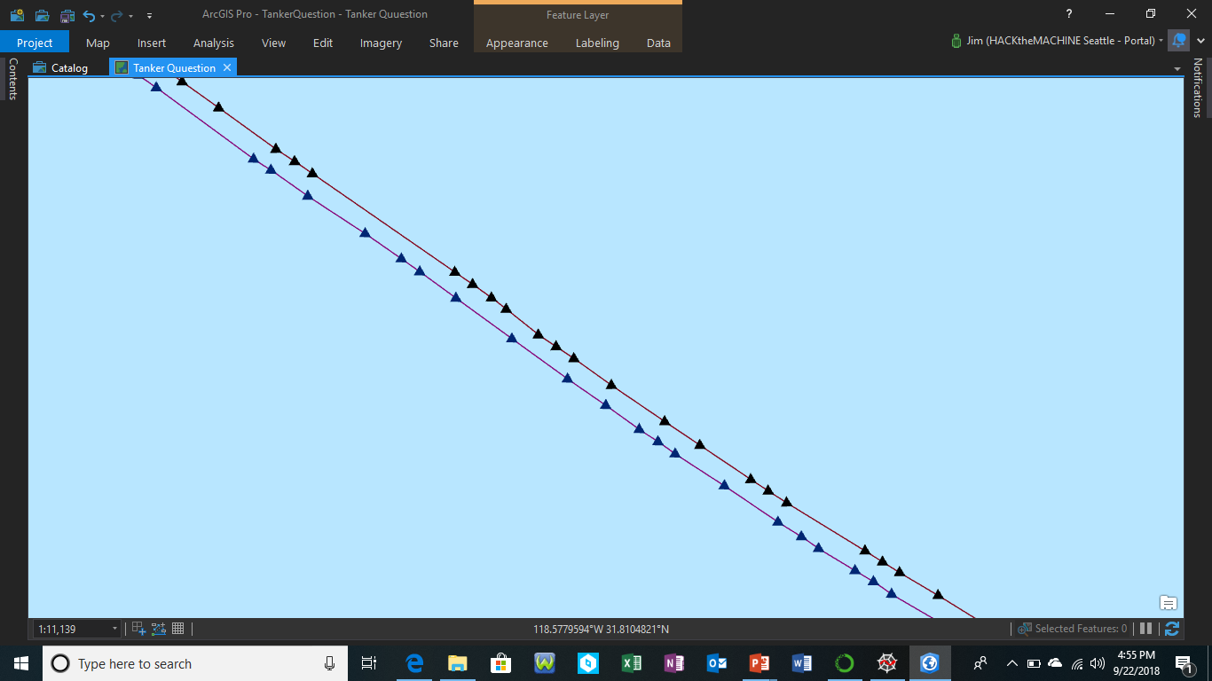
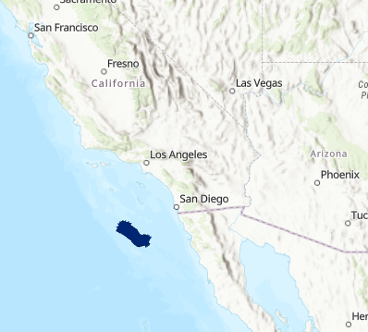
Tanker Investigation For Similar Data
So what?
Two ships in close proximity 552 times seemed strange. Upon further investigation, it shows that oil tankers will sail closely in parallel with around the same speed.
Therefore, had to do filtering of safe close proximity cases.

Slide 10
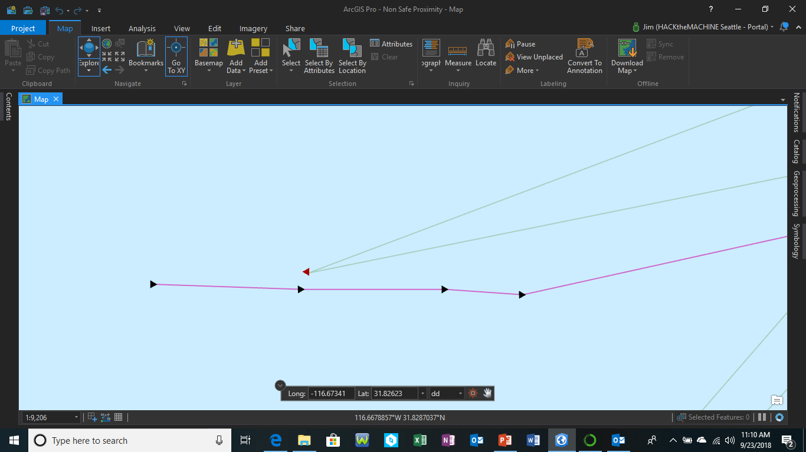
COLREG - Crossing Collision Course Before Redirection
So what?
Can predict when a ship has to redirect because they also see the potential collision.

Slide 11
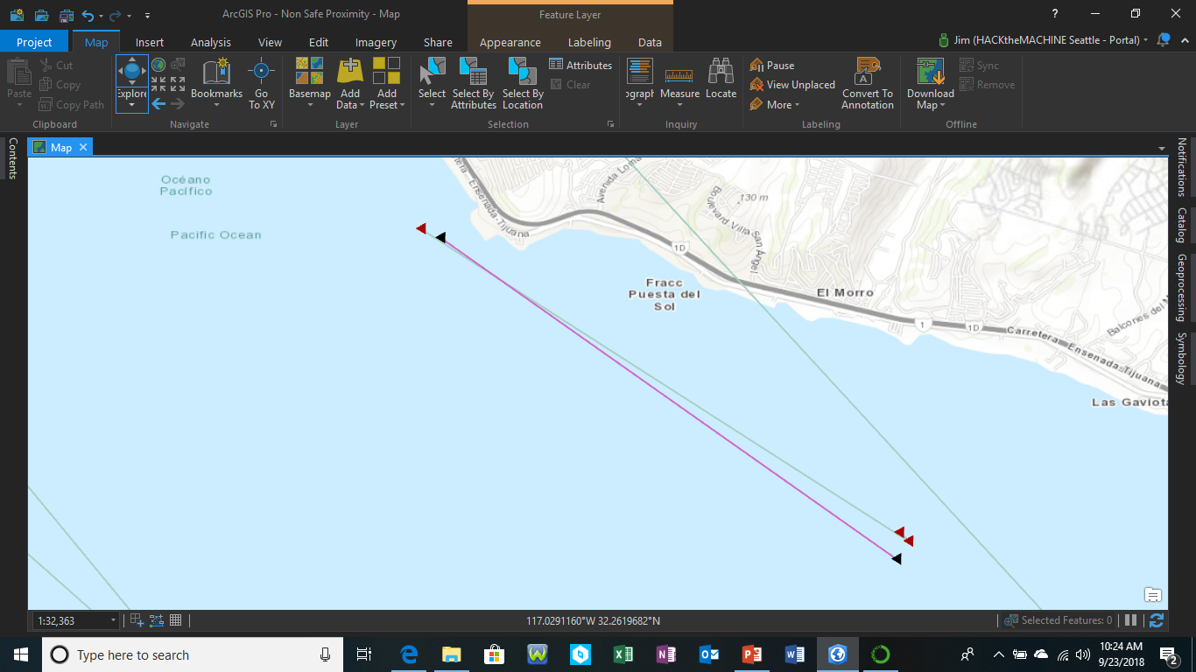
COLREG - Over Take
Red – Ship number 1 (AIS Data Field MMSI_1)
Black – Ship number 2 (AIS Data Field MMSI_2)

Slide 12
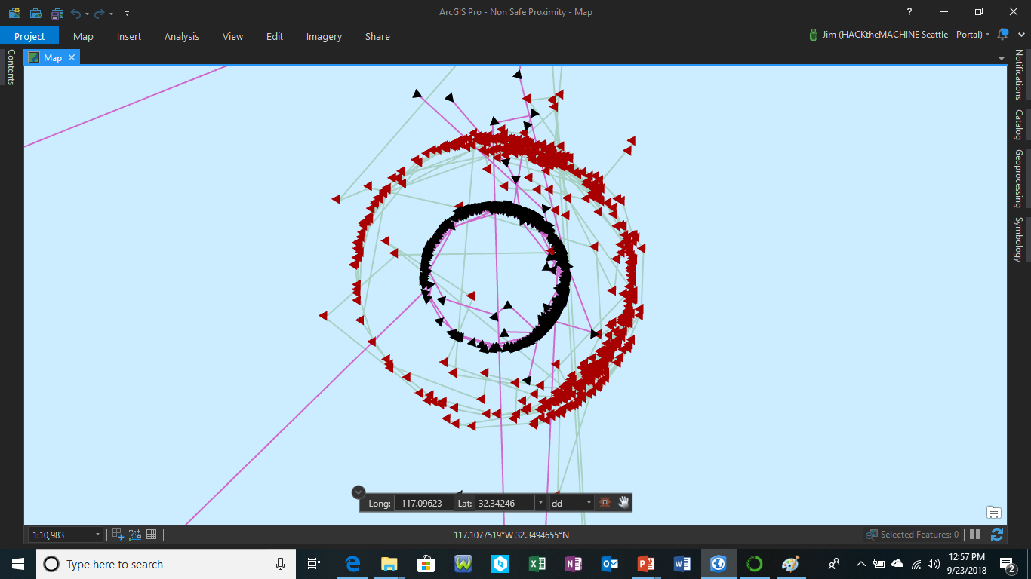
Potential Head on Collisions

Slide 13
Ship Track Predictions
Model: Recurrent Neural Network

Slide 14
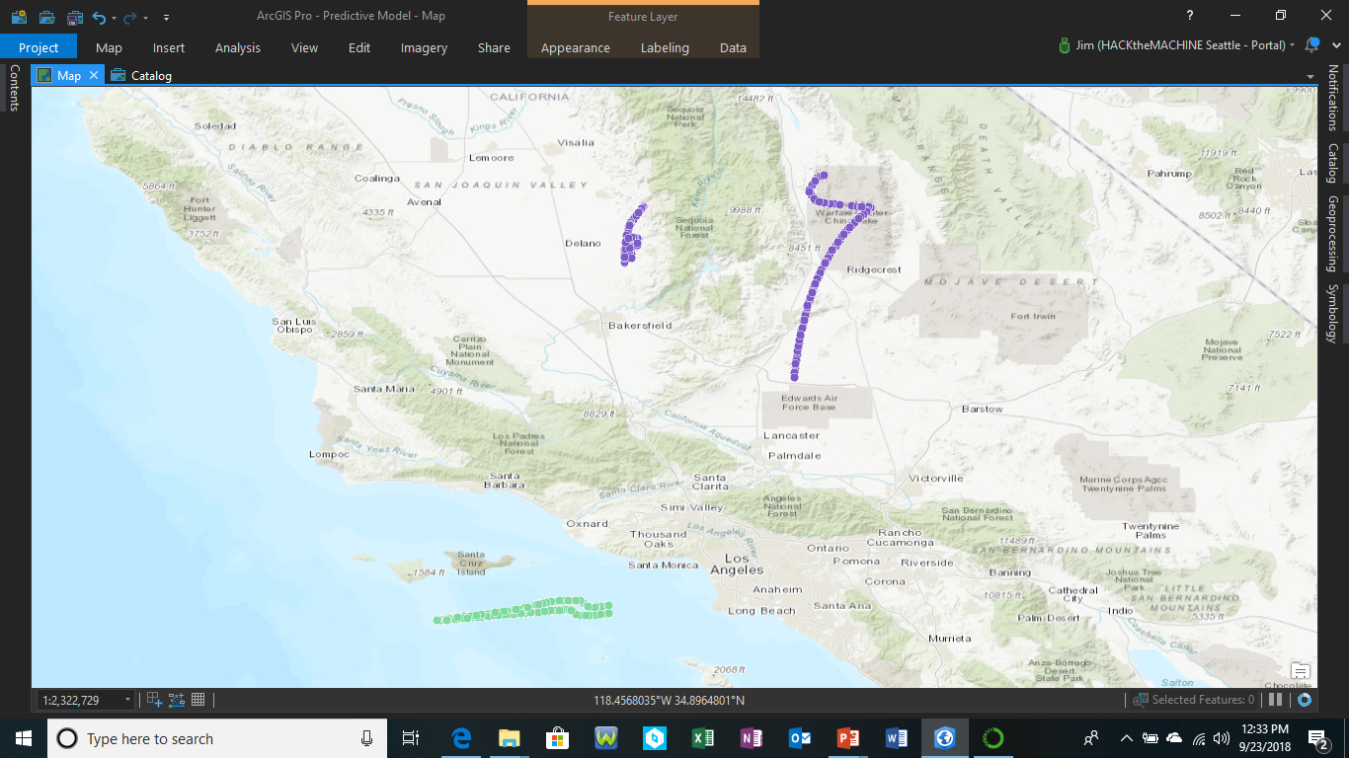
Both points ~ 150m from actual

Slide 15
Thank you

